Slide 1
Welcome to my presentation

Slide 2
Submitted To :
Name: Md. Imran Hossain
Assistant Professor
Dept. of ICT
Comilla University
Submitted By:
Name: Md. Ashraful Alam
ID: 11809032
Dept. of ICT
Comilla University

Slide 3
Intermediate Frequencies and IF Amplifiers.

Slide 4
Intermediate Frequency (IF) :
An intermediate frequency is a low frequency to which a signal is converted before demodulation in heterodyne reception. It is created by mixing carrier signal with local oscillator.

Slide 5
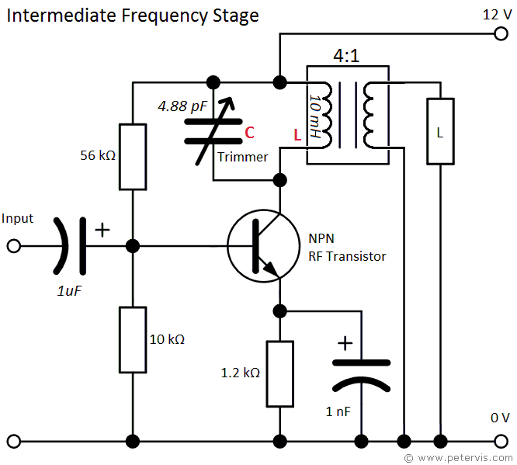

Slide 6
IF Amplifiers:
An intermediate frequency (IF) amplifier is a linear fixed-frequency tuned amplifier, found in the IF stage of a super-heterodyne radio receiver.
It is typically a common emitter Class-A amplifier which has the purpose of providing selective gain within a narrow frequency range.

Slide 7
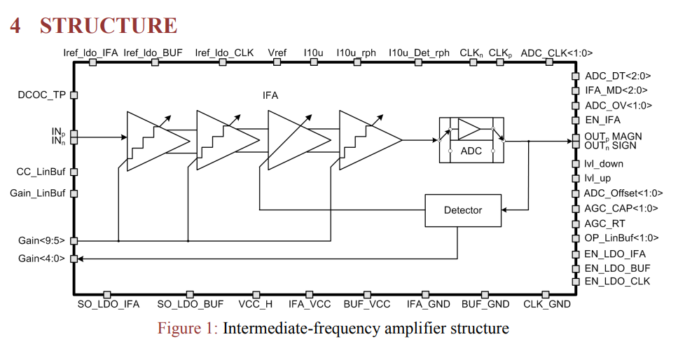

Slide 8
Choice of Frequencies :
The following are the major factors influencing the choice of the Intermediate Frequency Amplifier in any particular system :
1 . If the Intermediate Frequency Amplifier is too high, poor selectivity and poor adjacent-channel rejection result unless sharp cutoff (e.g., crystal or mechanical) filters are used in the IF stages.
2 . A high value of intermediate frequency increases tracking difficulties.
3 . A very low Intermediate Frequency Amplifier can make the selectivity too sharp, cutting off the sidebands.
4 . If the IF is very low, the frequency stability of the local oscillator must be made correspondingly higher because any frequency drift is now a larger proportion of the low IF than of a high IF.
5 . The Intermediate Frequency Amplifier must not fall within the tuning range of the receiver, or else instability will occur and heterodyne whistles will be heard, making it impossible to tune to the frequency band immediately adjacent to the intermediate

Slide 9
Frequency Used :
Standard broadcast AM receivers [tuning to 540 to 1650 kHz, perhaps 6 to 18 MHz, and possibly even the European long-wave band (150 to 350 kHz)] use an IF within the 438- to 465-kHz range, with 455 kHz by far the most popular.
AM, SSB and other receivers employed for shortwave or VHF reception have a first IF often in the range from about 1.6 to 2.3 MHz, or else above 30 MHz. (Such receivers have two or more different Intermediate Frequency Amplifier.)
FM receivers using the standard 88- to 108-MHz band have an IF which is almost always 10.7 MHz.
Television receivers in the VHF band (54 to 223 MHz) and in the UHF band (470 to 940 MHz) use an IF between 26 and 46 MHz, with approximately 36 and 46 MHz the two most popular values.
Microwave and radar receivers, operating on frequencies in the 1- to 10-GHz range, use intermediate frequencies depending on the application, with 30, 60 and 70 MHz among the most popular.

Slide 10
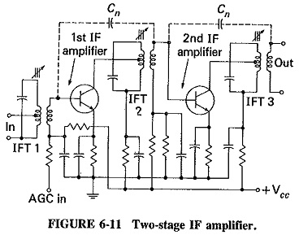
Block Diagram of a two-Stage IF Amplifier :

Slide 11
THANK YOU VERY MUCH

